Slide 1


Career Technical
Education (CTE)
Overview

Slide 2
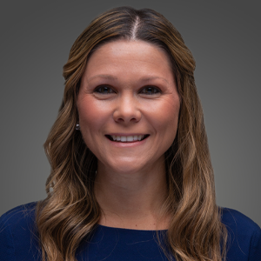
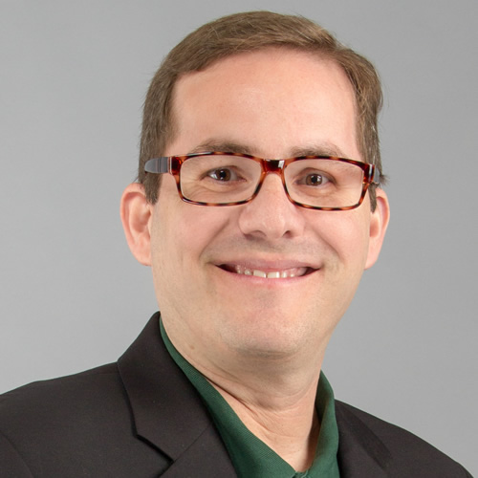

Chelsea Williams, Coordinator williamsc9@leonschools.net
850.487.7620
Sean Friend, Coordinator friends@leonschools.net
850.487.7602
District K-12 CTE Staff
https://www.fldoe.org/academics/career-adult-edu/career-tech-edu/ngos/

Slide 3
Education is a function of both knowledge and the application of knowledge. Education that ties abstract ideas to practical applications also prepares students to use their minds, as well as preparing them to be citizens, parents, and members of a civilized culture. Career technical education and academic education are complementary rather than exclusive. CTE courses/pathways are beneficial for ALL students.
Career and technical education will provide experiences that complement and reinforce academic concepts that are particularly amendable to contextualized learning in distinct career areas and provide occupationally specific skills.
Why Career Technical Education?
https://www.fldoe.org/academics/career-adult-edu/career-tech-edu/ngos/

Slide 4

Leon County Schools offers career and technical programs that include but are not limited to:
Job preparatory course designed to provide students with the competencies necessary for effective entry into an occupation
Exploratory courses designed to give students initial exposure to skills and attitudes associated with a broad range of occupations in order to assist them in making informed decision regarding their future academic and occupational goals;
Practical art courses are designed to teach students practical generic skills which, although applicable in some occupations, are not designed to prepare students for entry into an occupation;
Career education instruction which is designed to strengthen and integrate basic academic skills and career/technical skills and occupational awareness;
Accelerated career and technical programs such as career dual enrollment designed to enable high school students to earn elective credit toward graduation and postsecondary credit toward a technical certificate.
Why Career Technical Education?
https://www.fldoe.org/academics/career-adult-edu/career-tech-edu/ngos/

Slide 5

CTE: Myths and Facts
Myth: CTE is jobs training.
Fact: CTE empowers learners to explore multiple career options.
Myth: CTE leads to dead end jobs with low wages.
Fact: CTE leads to well-paying careers with potential for career advancement.
Myth: CTE is for low-performing students or students who don’t go on to college or post-secondary training.
Fact: CTE provides ALL learners a seamless pathway to post-secondary education.
Myth: CTE programs aren’t relevant if a students doesn’t know what career they want?
Fact: Experiencing CTE in high school is a good way to test-drive a career before spending money on additional training after high school.

Slide 6
The following statutes contain important provisions of the Florida Career and Professional Education Act (CAPE Act):
Section 1003.4203 – Digital materials, CAPE Digital Tool certificates, and technical assistance
Section 1003.491 – Florida Career and Professional Education Act
Section 1003.492 – Industry-certified career education programs
Section 1003.493 – Career and professional academies and career-themed courses
Section 1003.4935 – Middle grades career and professional academy courses and career-themed courses
Section 1008.44 – CAPE Industry Certification Funding List and CAPE Postsecondary Industry Certification Funding List
Section 1011.62(1)(o) – Calculation of additional full-time equivalent membership based on successful completion of a career-themed course pursuant to ss. 1003.491, 1003.492, and 1003.493, or courses with embedded CAPE industry certifications or CAPE Digital Tool certificates, and issuance of industry certification identified on the CAPE Industry Certification Funding List pursuant to rules adopted by the State Board of Education or CAPE Digital Tool certificates pursuant to s. 1003.4203.
Florida Statutes
https://www.fldoe.org/academics/career-adult-edu/cape-secondary/statutes-rules.stml

Slide 7
Elementary School
Career Awareness
Middle School
Career Exploration
High School
Career Preparation
The Role of K-12 and CTE

Slide 8
Programs
K-12
Middle School and Career Exploratory
Career Preparatory
Technology Education
Work-based Learning and Capstone Courses
All other including practical arts, single course programs and courses for special needs population
Postsecondary
Apprenticeship
Career Certificate
Applied Technology Diploma
College Credit Certificate
Associate in Science/Associate in Applied Science
Workforce Baccalaureate Degrees

Slide 9
CTE programs are organized into 17 different career clusters and are geared toward middle school, high school, district technical school, and Florida College System students throughout the state.
Career Clusters
Career Cluster
Agriculture, Food & Natural Resources | Engineering & Technology | Information Technology
Architecture & Construction | Finance | Law, Public Safety & Security
Arts, A/V Technology & Communication | Government & Public Administration | Manufacturing
Business Management & Administration | Health Science | Marketing, Sales, & Service
Education & Training | Hospitality & Tourism | Transportation, Distribution & Logistics
Energy | Human Services
https://www.fldoe.org/academics/career-adult-edu/career-tech-edu/

Slide 10
CAPE Act
In 2007, the Florida Legislature passed the Career and Professional Education Act. The purpose of the act was to provide a statewide planning partnership between the business and education communities in order to attract, expand, and retain targeted, high-value industry and to sustain a strong, knowledge-based economy. The objectives of the act are as follows:
To improve middle and high school academic performance by providing rigorous and relevant curriculum opportunities;
To provide rigorous and relevant career-themed courses that articulate to postsecondary level coursework and lead to industry certification;
To support local and regional economic development;
To respond to Florida's critical workforce needs; and
To provide state residents with access to high-wage and high-demand careers
https://www.fldoe.org/core/fileparse.php/8904/urlt/cape-act-techassist.pdf

Slide 11
CAPE Act Continued
The key feature of the CAPE Act is the list of approved certifications known as the “CAPE Industry Certification Funding List,” which is the list of fundable industry certifications adopted by the State Board of Education.
Type of Certification of Certificate | Description
CAPE Digital Tool Certificates | To earn a certificate, students must pass an assessment of digital skills in the following areas: word processing; spreadsheets; sound, motion and color presentations; digital arts; cybersecurity. The certificates are available to students in elementary school and middle school grades.
CAPE Industry Certifications | These are industry certifications that either do not articulate for college credit or do articulate for up to 14 college credits based on a statewide articulation agreement. The certifications are available to students in grades 6 through 12.
CAPE Acceleration Industry Certifications | These are industry certifications that articulate for 15 or more college credit credits based on a statewide articulation agreement.
https://www.fldoe.org/core/fileparse.php/8904/urlt/cape-act-techassist.pdf

Slide 12
CAPE Funding
Certifications have differential weights for the add-on FTE calculation in s. 1011.62(1)(o), F.S. There are six values: 0.025, 0.1, 0.2, 0.3, 0.5, and 1.0. Funding weights are assigned based on the type of certificate, certification, and course as follows:
Funding Weight | Type of Certificate/Certification/Course
0.025 FTE | CAPE Digital Tool Certificate
0.1 FTE | CAPE Industry Certification (no articulation agreement)
0.2 FTE | CAPE Industry Certification with a statewide articulation agreement of up to 14 college credits
0.3 FTE | CAPE Innovation Course for students who pass all of the required assessments
0.5 FTE | CAPE Acceleration Industry Certification with a statewide articulation agreement of 15 to 29 college credits
1.0 FTE | CAPE Acceleration Industry Certification with a statewide articulation agreement of 30 or more college credits
https://www.fldoe.org/academics/career-adult-edu/cape-secondary/faq.stml

Slide 13
The Division of Career and Adult Education is responsible for developing educational programs that prepare individuals for the occupations that are important to Florida’s economic development. Per F.S. §1004.92(2)(b)(4), each program is updated every three (3) years to reflect current business and industry needs specific to the occupation for which it prepares. With the help of educators, business and industry representatives, and trade associations, career and adult education programs are aligned with the skill requirements needed in today's workforce.
A program of study is a coherent, articulated sequence of rigorous academic and career courses commencing in the 9th grade (or sometimes earlier) leading to an associate degree, an industry-recognized certification or licensure, and/or a baccalaureate degree.
Programs of Study
https://www.fldoe.org/academics/career-adult-edu/career-tech-edu/ngos/

Slide 14
Curriculum Frameworks
The Curriculum Frameworks identify specific programs/pathways for each of the
17 career clusters. Within each cluster, the frameworks identify the aligned:
Middle School Courses
Secondary Courses/Programs
Career Certificate Programs
Degree & Certificate Programs
Supplemental Courses
https://www.fldoe.org/academics/career-adult-edu/career-tech-edu/curriculum-frameworks/2022-23-frameworks/

Slide 15
Curriculum Frameworks
Within the identified course/program/pathway, the state has identified the following:
Middle School Framework Outline: By Course
Program Number
Grade Level & Length
Aligned Career Technical Student Organization (CTSO)
Purpose
Course Structure
Course Description
Standards & Benchmarks
Laboratory Activities
Florida Standards for English Language Development
Accommodations
MIDDLE SCHOOL
https://www.fldoe.org/academics/career-adult-edu/career-tech-edu/curriculum-frameworks/2022-23-frameworks/

Slide 16
Curriculum Frameworks
Program Course Example :
Program Title: Information & Communications Technology (ICT) Essentials
Program Type: Orientation/Exploratory
Career Cluster: Information Technology
Secondary – Middle School
Program Number | 9009100
CIP Number | 149009100M
Grade Level | 6-8
Standard Length | Year
Teacher Certification | Refer to the Program Structure section.
CTSO | FBLA BPA
CTE Program Resources | http://www.fldoe.org/academics/career-adult-edu/career-tech-edu/program-resources.stml
MIDDLE SCHOOL
https://www.fldoe.org/academics/career-adult-edu/career-tech-edu/curriculum-frameworks/2022-23-frameworks/

Slide 17
Curriculum Frameworks
Program Structure Example :
Course Number | Course Title | Teacher Certification | Length
9009110 | Information & Communications Technology (ICT) Essentials 1 | BUS ED 1 @2 COMPU SCI 6 INFO TECH 7G WEB DEV 7G | Year
9009120 | Information & Communications Technology (ICT) Essentials 2 |  | Year
9009130 | Information & Communications Technology (ICT) Essentials 3 |  | Year
MIDDLE SCHOOL
https://www.fldoe.org/academics/career-adult-edu/career-tech-edu/curriculum-frameworks/2022-23-frameworks/

Slide 18
Curriculum Frameworks
Within the identified course/program/pathway, the state has identified the following:
High School Framework Outline
Program Number & Length (number of courses within program)
Aligned Career Technical Student Organization (CTSO)
Purpose
Program Structure
Career Ready Practices
Standards and Benchmarks
Laboratory Activities
Academic Alignment
Florida Standards for English Language Development
Accommodations
HIGH SCHOOL
https://www.fldoe.org/academics/career-adult-edu/career-tech-edu/curriculum-frameworks/2022-23-frameworks/

Slide 19
Curriculum Frameworks
Program Pathway Example :
Program Title: Digital Design
Program Type: Career Preparatory
Career Cluster: Arts, A/V Technology and Communication
Secondary – Career Preparatory
Program Number | 8209600
CIP Number | 0510030306
Grade Level | 9-12
Standard Length | 6 credits
Teacher Certification | Refer to the Program Structure section.
CTSO | SkillsUSA FBLA
SOC Codes (all applicable) | 27-1024 – Graphic Designers 43-9031 – Desktop Publishers 15-1151 – Computer User Support Specialists
CTE Program Resources | http://www.fldoe.org/academics/career-adult-edu/career-tech-edu/program-resources.stml
HIGH SCHOOL
https://www.fldoe.org/academics/career-adult-edu/career-tech-edu/curriculum-frameworks/2022-23-frameworks/

Slide 20
Curriculum Frameworks
Program Structure Example :
Course Number | Course Title | Teacher Certification | Length | SOC Code | Level | Graduation Requirement
8207310 | Digital Information Technology | DIT Teacher Certifications | 1 credit | 15-1151 | 2 | PA
8209510 | Digital Design 1 | BUS ED 1 @2 CLERICAL @7 7G COMM ART @7 7G COMP SCI 6@2 MANAG SUPV 7G SECRETAR 7 G TC COOP ED @7 ELECT DP @7 %G TEC ED 1 @2 ENG&TEC ED1@2 | 1 credit | 43-9031 | 3 | PA
8209520 | Digital Design 2 | MANAG SUPV 7G BUS DP @7 %G BUS ED 1 @2 CLERICAL @7 7G COMM ART @7 7G COMP SCI 6 @2 ELECT DP @7 %G PRINTING @7 7G SECRETAR 7 G TC COOP ED @7 TEC ED 1 @2 ENG&TEC ED1@2 TEC ELEC $7 GVOE @7 | 1 credit | 43-9031 | 3 | PA
8209530 | Digital Design 3 |  | 1 credit | 43-9031 | 3 | PA
8209540 | Digital Design 4 |  | 1 credit | 27-1024 | 3 | PA
8209550 | Digital Design 5 |  | 1 credit | 27-1024 | 3 | PA
HIGH SCHOOL
https://www.fldoe.org/academics/career-adult-edu/career-tech-edu/curriculum-frameworks/2022-23-frameworks/

Slide 21
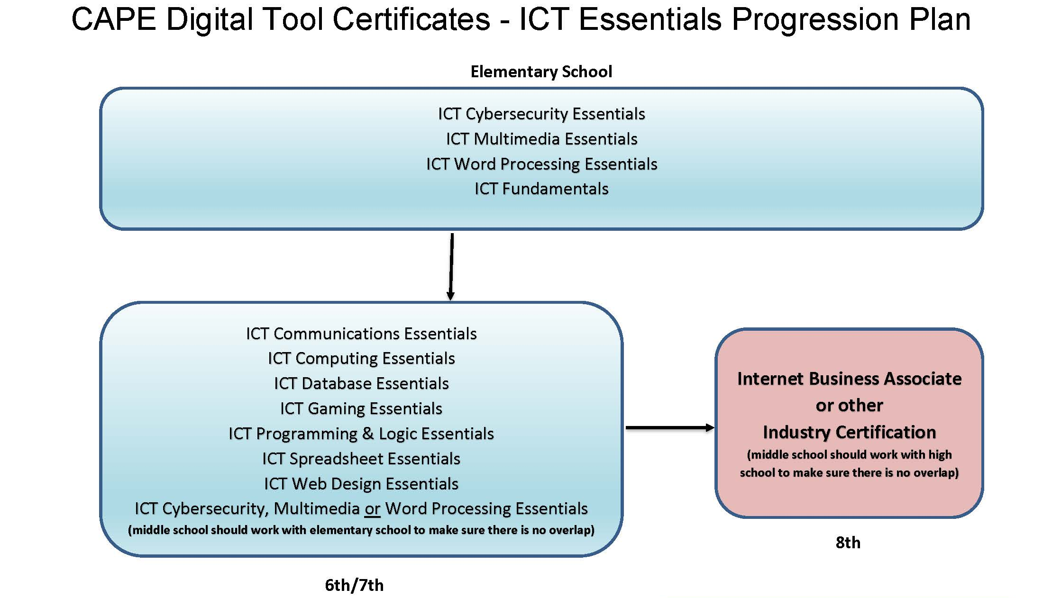
1003.4203 FS: The Legislature intends that by July 1, 2018, on an annual basis, at least 75 percent of public middle grades students earn at least one CAPE Digital Tool certificate. § 1003.4203, Fla. Stat. (2021)
http://leg.state.fl.us/statutes/index.cfm?mode=View%20Statutes&SubMenu=1&App_mode=Display_Statute&Search_String=1003.4203&URL=1000-1099/1003/Sections/1003.4203.html

Slide 22
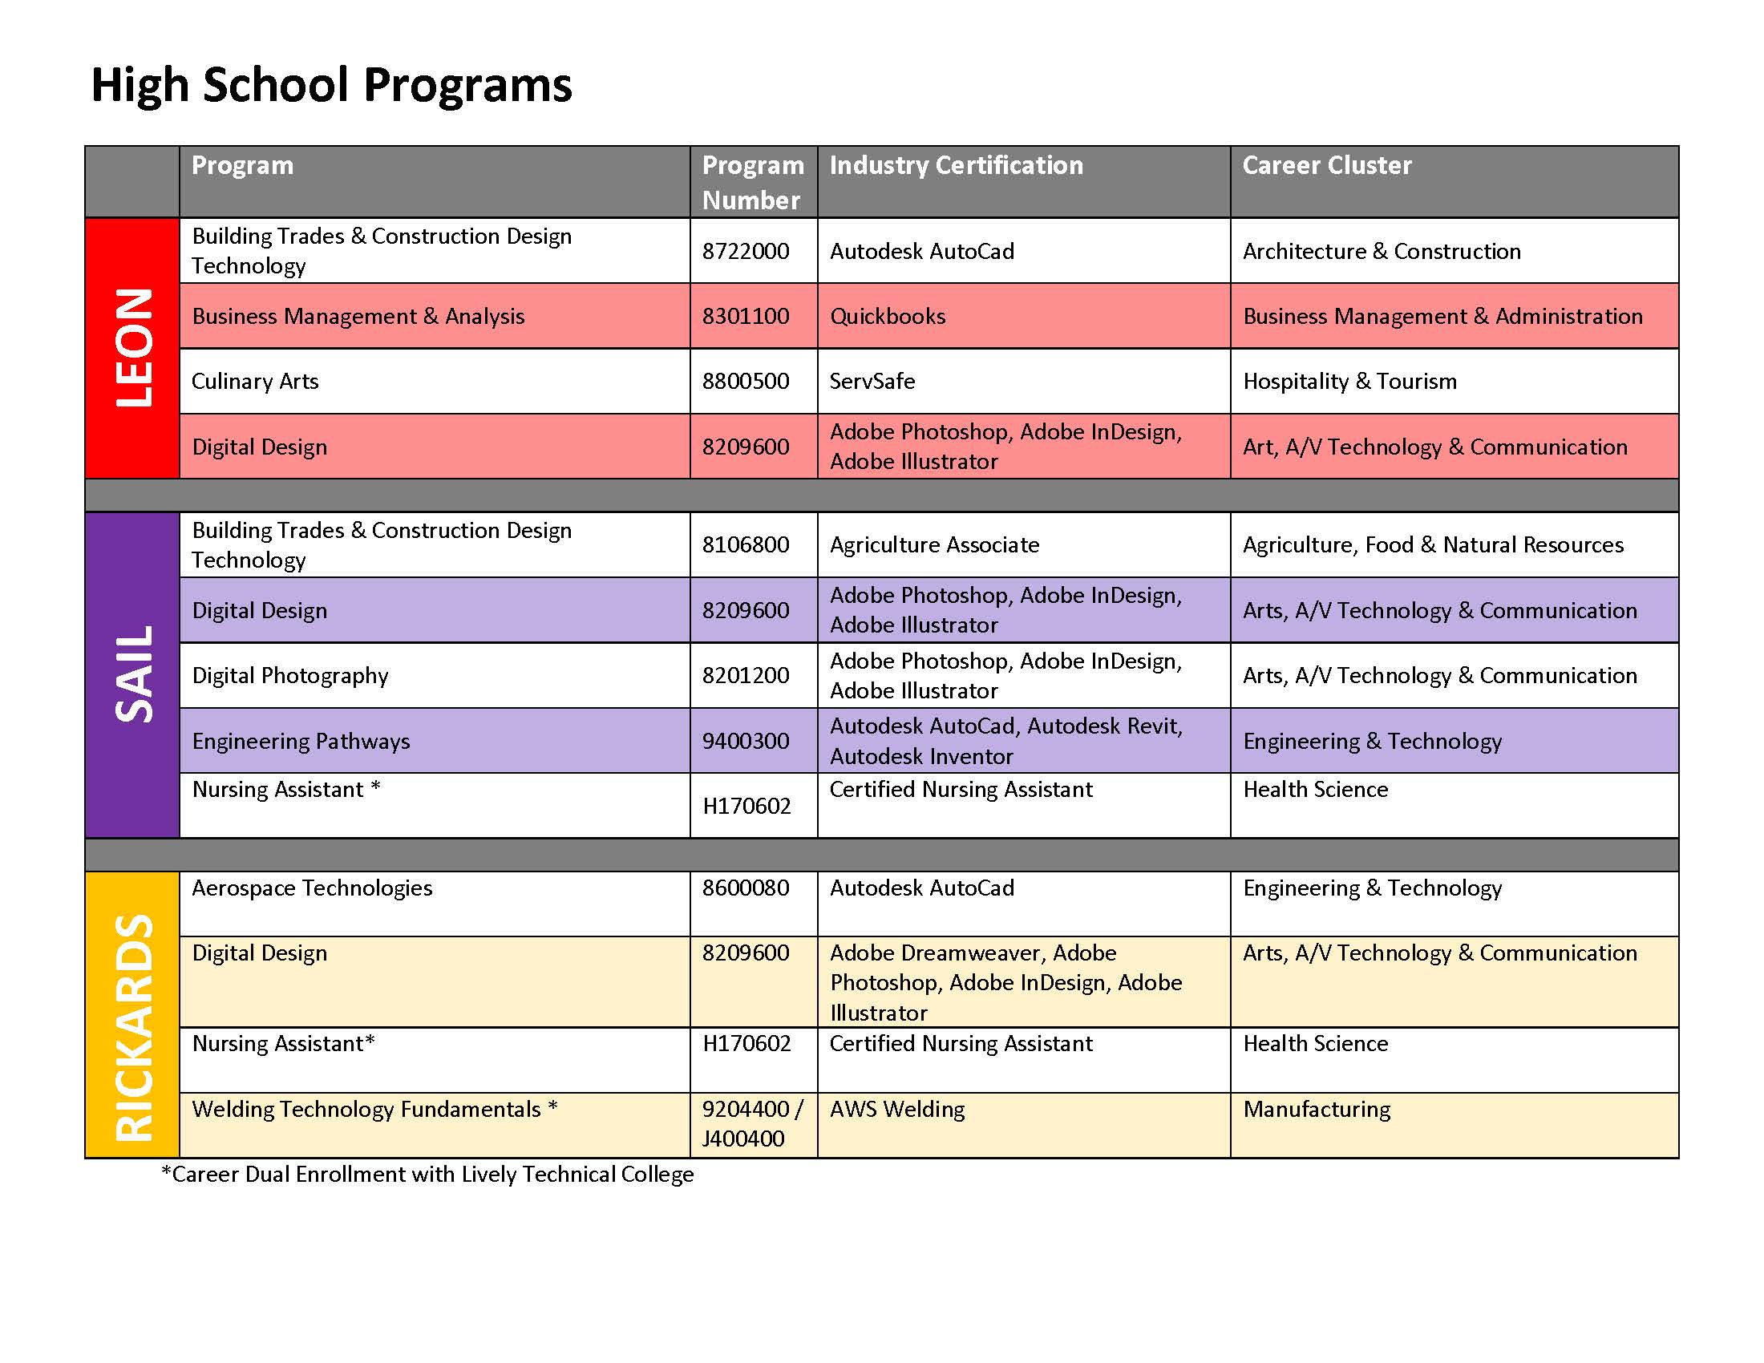

Slide 23
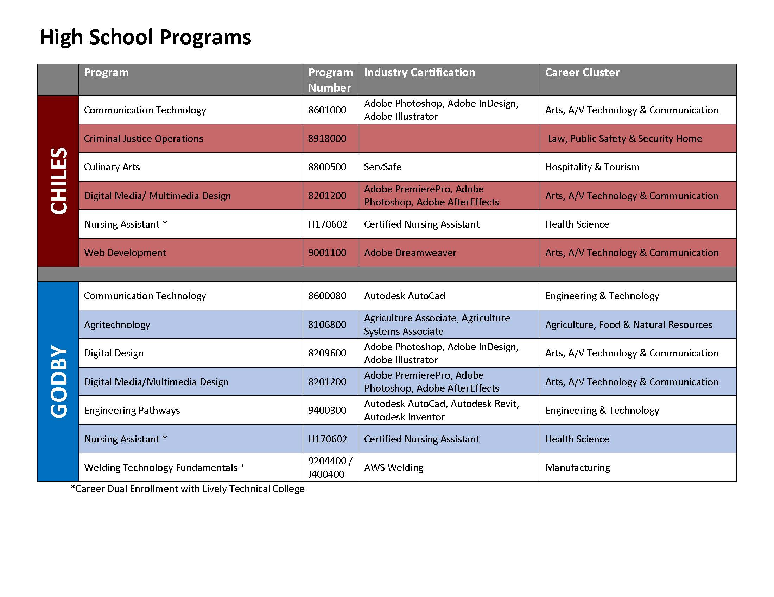

Slide 24
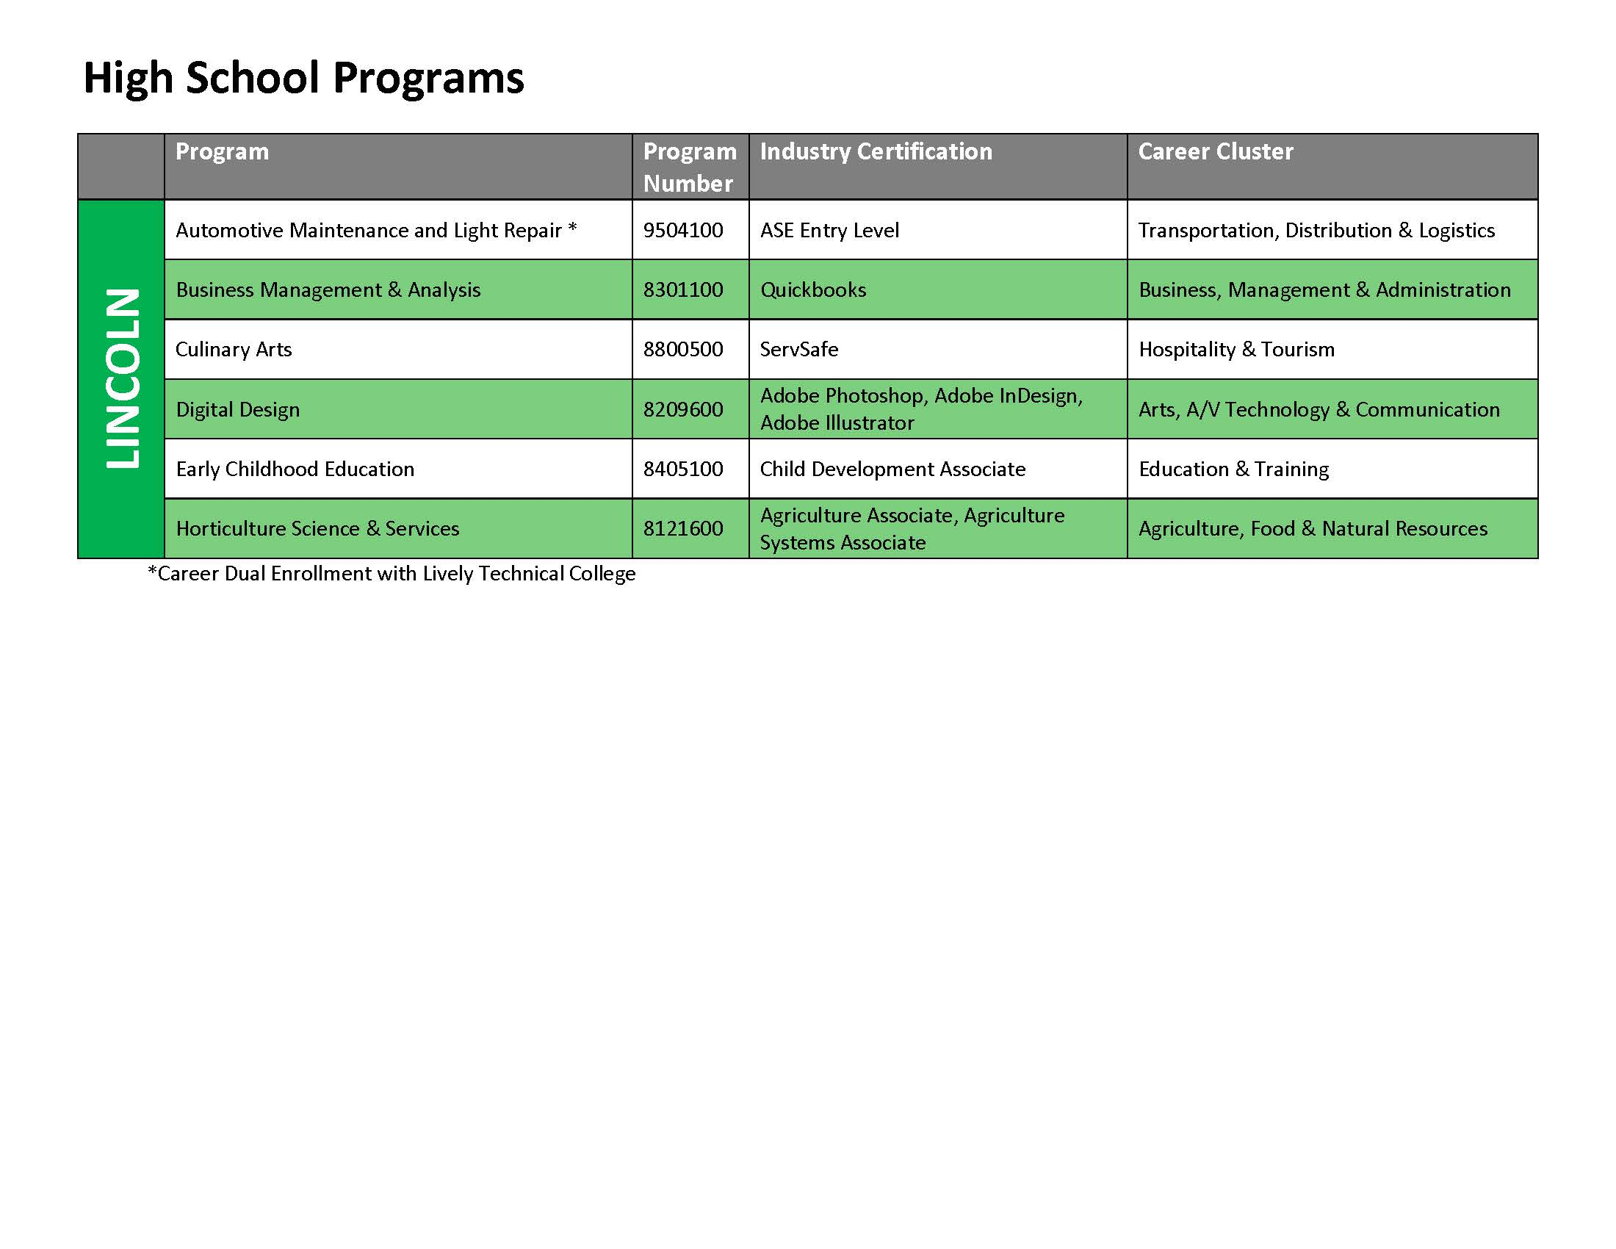

Slide 25
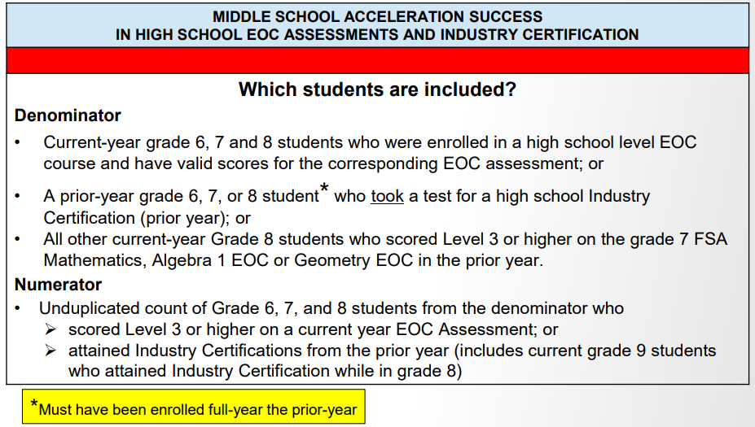
School Grades: Acceleration Middle
https://cdn5-ss14.sharpschool.com/UserFiles/Servers/Server_270532/File/About%20Us/Reports%20and%20Publications/School%20Grading/FLDOE%20School%20Grade%20Accountability%20Web%20Applications/V2%20-%20School%20Grade%20Calculation%20-%20All%20Schools-FY22_Update%20-%2002-17-2022.pdf

Slide 26
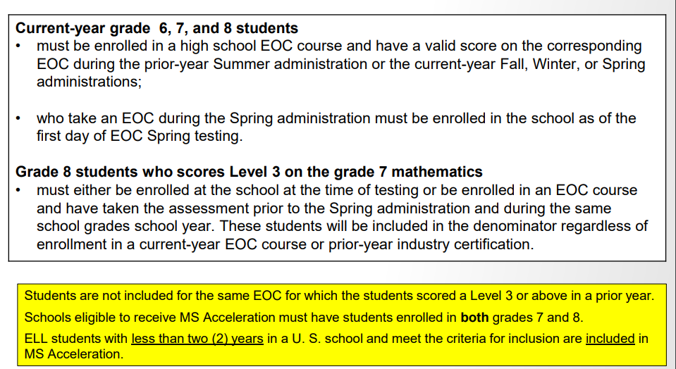
School Grades: Acceleration Middle
https://cdn5-ss14.sharpschool.com/UserFiles/Servers/Server_270532/File/About%20Us/Reports%20and%20Publications/School%20Grading/FLDOE%20School%20Grade%20Accountability%20Web%20Applications/V2%20-%20School%20Grade%20Calculation%20-%20All%20Schools-FY22_Update%20-%2002-17-2022.pdf

Slide 27
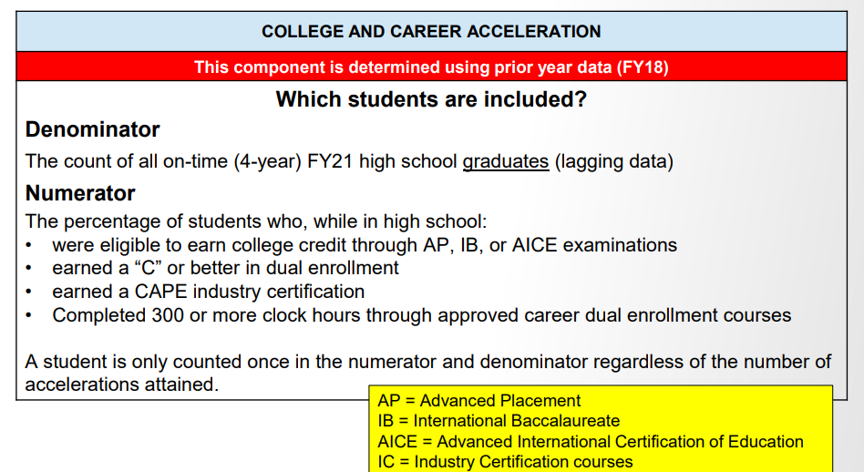
School Grades: Acceleration High
https://cdn5-ss14.sharpschool.com/UserFiles/Servers/Server_270532/File/About%20Us/Reports%20and%20Publications/School%20Grading/FLDOE%20School%20Grade%20Accountability%20Web%20Applications/V2%20-%20School%20Grade%20Calculation%20-%20All%20Schools-FY22_Update%20-%2002-17-2022.pdf

Slide 28
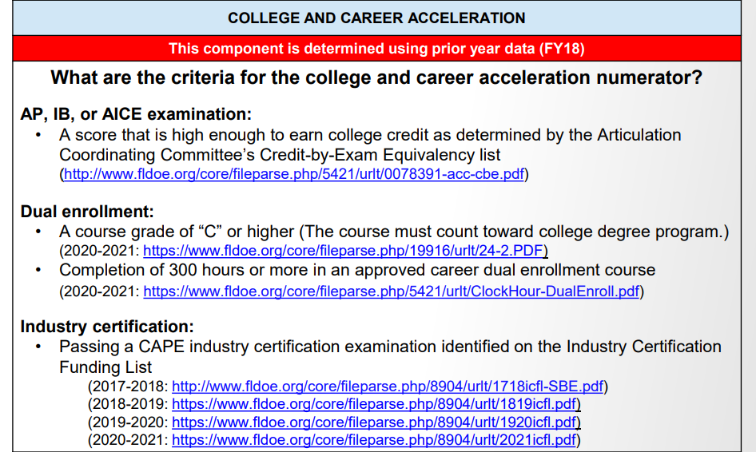
School Grades: Acceleration High
https://cdn5-ss14.sharpschool.com/UserFiles/Servers/Server_270532/File/About%20Us/Reports%20and%20Publications/School%20Grading/FLDOE%20School%20Grade%20Accountability%20Web%20Applications/V2%20-%20School%20Grade%20Calculation%20-%20All%20Schools-FY22_Update%20-%2002-17-2022.pdf

Slide 29
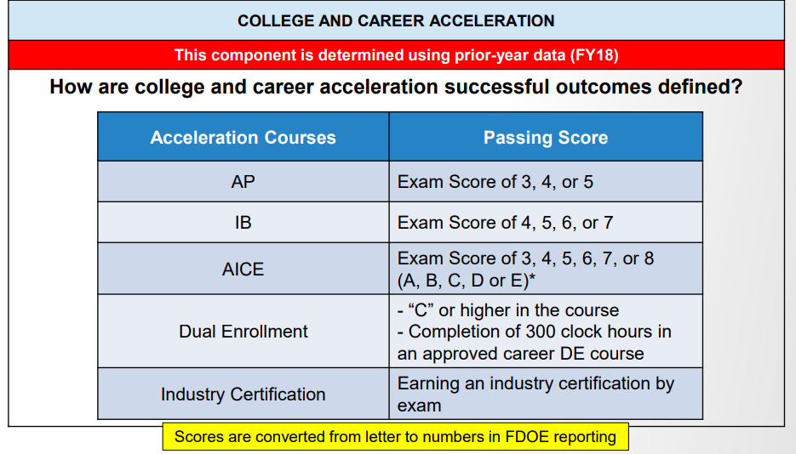
School Grades: Acceleration High
https://cdn5-ss14.sharpschool.com/UserFiles/Servers/Server_270532/File/About%20Us/Reports%20and%20Publications/School%20Grading/FLDOE%20School%20Grade%20Accountability%20Web%20Applications/V2%20-%20School%20Grade%20Calculation%20-%20All%20Schools-FY22_Update%20-%2002-17-2022.pdf

Slide 30
CTE K-12 Snapshot
2020-2021
Digital Tools Earned K-5: 251
Digital Tools Earned 6-8: 2545
Industry Certifications Earned 6-12: 1045
Total Bonus Funding: $868,708.00
2021-2022
Digital Tools Earned K-5: 1372
Digital Tools Earned 6-8: 2748
Industry Certifications Earned 6-12: 1306
*28 Different Industry Certifications Passed
Anticipated Bonus Funding: $1,374,847.20

Slide 31
CTE Course Substitutions
Students with Disabilities:
Rule 6A-1.09963, Florida Administrative Code (F.A.C.), permits students with disabilities who are using one of the standard high school diploma options outlined in section 1003.4282(10), Florida Statutes, (F.S.), to substitute CTE courses with “content related” for English 4, one math, one science and one social studies credit (excluding Algebra 1, Geometry, Biology 1, and U.S. History). https://www.fldoe.org/core/fileparse.php/7571/urlt/ctesubstitutions.pdf
http://project10.info/Documents/CTE_Course_Sub_TA_brief-for_Posting_11.18.20_1.pdf
Graduation Requirements:
CTE Courses can fulfill the graduation designations for economics, equally rigorous science and practical art requirement. https://www.fldoe.org/academics/career-adult-edu/career-tech-edu/program-resources.stml

Slide 32
Industry Cert. Substitutions
Industry Certification Mathematics and Science Substitutions – s. 1003.4282(3)(b) and (c), F.S.
A student who earns an industry certification for which there is a statewide college-credit articulation agreement approved by the State Board of Education may substitute the certification for two mathematics credits, except for Algebra 1 and Geometry.
A student who earns an industry certification for which there is a statewide college-credit articulation agreement approved by the State Board of Education may substitute the certification for up to one science credit, except for Biology 1.
One qualifying industry certification attainment equates to one substitution credit. A student would need to
earn three distinct industry certifications to earn the maximum of three substitution credits (two in
mathematics and one in science).
http://www.fldoe.org/academics/career-adult-edu/career-technical-edu-agreements/industry-certification.stml.

Slide 33
Industry Cert. Substitutions Cont.
Course substitution options related to mathematics and science include the following:
An identified computer science credit may substitute for up to one credit of the mathematics requirement, with the exception of Algebra 1 and Geometry (s. 1003.4282(3)(b)3., F.S.).
An identified computer science credit may substitute for up to one credit of the science requirement, with the exception of Biology 1 ( s. 1003.4282(3)(c)3., F.S.).
An identified industry certification in 3D rapid prototype printing may satisfy up to two credits of the mathematics requirements, with the exception of Algebra 1 (s. 1003.4282(3)(b)3., F.S.).
https://www.fldoe.org/core/fileparse.php/7764/urlt/SecondaryStudentProgressionFAQ.pdf

Slide 34
CTE Graduation Pathway Option
Beginning with the 2019-2020 school year, a student may earn a standard high school diploma through the Career and Technical Education (CTE) pathway option. To earn a standard high school diploma through this pathway option, a student must:
Successfully complete a minimum of 18 credits.
Have a minimum, cumulative GPA of at least a 2.0 on a 4.0 scale.
Meet the requirements of
  4 English credits (including the statewide grade 10 Reading assessment or the grade 10 ELA assessment, or earn a concordant score)
  4 Math credits (including the statewide Algebra I EOC assessment, or earn a comparative score)
  3 Science credits
  3 Social studies credits
Complete two credits in career and technical education. The courses must result in a program completion and an industry certification.
Complete two credits in work-based learning programs. A student may substitute up to two credits of electives, including one-half credit in financial literacy, for work-based learning program courses to fulfill this requirement.
Each district school board must incorporate the CTE pathway option into the student progression plan required under s. 1008.25.
https://www.fldoe.org/academics/career-adult-edu/career-tech-edu/pathways-option.stml

Slide 35
Career Dual Enrollment
Career Dual Enrollment (CDE) is an option for high school students to enroll in post-secondary courses to earn elective credit toward high school graduation requirements and to receive hours toward a career and technical post-secondary program certificate.
CDE includes courses offered through career certificate (clock hour) programs and career associate degree programs (e.g., Associate of Science). The high school credits are awarded upon completion of the postsecondary course.
For Career Certificate clock hour courses taken through dual enrollment, the following methodology must be used for the awarding of high school credits: 0.5 high school credit for each 75 hours in the course rounded down to the nearest 0.5 credit.
Lively Technical College (LTC) offers CDE options on high school campuses and on the main LTC campus.
https://www.livelytech.com/students/dual-enrollment/
https://www.fldoe.org/core/fileparse.php/5421/urlt/CareerTechList1920.pdf

Slide 36
Master List of Resources https://www.fldoe.org/academics/career-adult-edu/cte-educator-resources/
CTE New Teacher Resources: https://www.fldoe.org/core/fileparse.php/5652/urlt/CTE-NewTeacherResources.pdf
Career Cluster Infographics: https://www.fldoe.org/core/fileparse.php/5652/urlt/CareerClusterInfographics.pdf
CTE Pathway Option for a Standard High School Diploma https://www.fldoe.org/academics/career-adult-edu/career-tech-edu/pathways-option.stml
CAPE Industry Certification Reporting https://www.fldoe.org/academics/career-adult-edu/research-evaluation/cape-industry-certification.stml
Cooperative Education OJT Resources & Educator Manual https://www.fldoe.org/academics/career-adult-edu/career-tech-edu/additional-cte-programs-courses/ojt/
Resources

Slide 37

Lively Technical College is a post-secondary, clock-hour institution that has been serving the community since 1937.
Mission:
The mission of Lively Technical College is to provide career-oriented education for the community.
Vision:
Our vision is to lead workforce training by utilizing industry driven educational solutions and community partnerships to equip students to meet the needs of local and global employers.
https://www.livelytech.com/
https://www.livelytech.com/wp-content/uploads/2020/09/20.21-Annual-Report-Electronic.pdf

Slide 38
Programs
ARCHITECTURE AND CONTRUCTION
Air Conditioning Refrigeration & Heating Technology 1 (HVAC 1)*
Air Conditioning Refrigeration & Heating Technology 2 (HVAC2)*
Building Trades and Construction Design Technology*
Electricity*
Industrial Pipefitter*
ARTS, A/V TECHNOLOGY & COMMUNICATION
Digital Design 1*
Digital Design 2*
Digital Media / Multimedia Design*
BUSINESS MANAGEMENT & ADMINISTRATION
Legal Administrative Specialist*
Medical Administrative Specialist*
HOSPITALITY & TOURISM
Baking & Pastry Arts
Professional Culinary Arts & Hospitality*
Fundamental Foodservice Skills
HUMAN SERVICES
Barbering
Cosmetology
Nails Specialty
Facials Specialty
High School Dual Enrollment Available for Most Programs
* 2021-22 Perkins Fundable Programs
https://www.livelytech.com/

Slide 39

HEALTH SCIENCE
Medical Assisting*
Nursing Assistant*
Patient Care Technician*
Practical Nursing*
Phlebotomy*
MANUFACTURING
Welding Technology*
Welding Technology- Advanced
TRANSPORTATION, DISTRIBUTION & LOGISTICS
Automotive Service Technology 1 & 2*
Aviation Airframe Mechanics*
Aviation Powerplant Mechanics*
Diesel Maintenance Technician*
Diesel Systems Technician 1*
Diesel Systems Technician 2*
SHORT COURSES
Motorcycle
CDL 3rd Party Tester
IV Therapy
High School Dual Enrollment Available for Most Programs
* 2021-22 Perkins Fundable Programs
https://www.livelytech.com/

Slide 40

Licenses/Certifications
https://www.livelytech.com/

